Slide 1
Chapter 17
Object-Oriented Design and Modeling Using the UML
Notes:
This repository of slides is intended to support the named chapter. The slide repository should be used as follows:
Copy the file to a unique name for your course and unit.
Edit the file by deleting those slides you don’t want to cover, editing other slides as appropriate to your course, and adding slides as desired.
Print the slides to produce transparency masters or print directly to film or present the slides using a computer image projector.
Each slide includes instructor notes. To view those notes in PowerPoint, click-left on the View Menu; then click left on Notes View sub-menu. You may need to scroll down to see the instructor notes.
Teaching Notes
This slide shows the how this chapter's content fits with the building blocks framework used throughout the textbook. The emphasis of this chapter is with the physical design phase, focusing on COMMUNICATION. It involves system designers and systems analysts.

Slide 2
Objectives
Understand entity, interface, control, persistence, and system classes.
Understand the concepts of dependency and navigability.
Define visibility and explain its three levels.
Understand the concept object responsibility and how it is related to message sending between object types.
Describe the activities involved in object-oriented design.
Differentiate between a design use-case narrative and an analysis use-case narrative.
Describe CRC card modeling.
Model class interactions with sequence diagrams.
Construct a class diagram that reflects design specifics.
Model object states with state machine diagrams.
Notes:
No additional notes.

Slide 3
Object-Oriented Design
Object-oriented design (OOD) – an approach used to specify the software solution in terms of collaborating objects, their attributes, and their methods.
Continuation of object-oriented analysis
Notes:
Teaching Notes
The approach of using object-oriented techniques for designing a system is referred to as object-oriented design. Recall that object-oriented development approaches are best suited to projects that will implement systems using emerging object technologies to construct, manage, and assemble those objects into useful computer applications. Object-oriented design is the continuation of object-oriented analysis (Chapter 9), continuing to center the development focus around object modeling techniques.
During object-oriented design, entity objects are refined while other types of objects are identified that will be introduced as the result of physical implementation decisions for the new system.

Slide 4
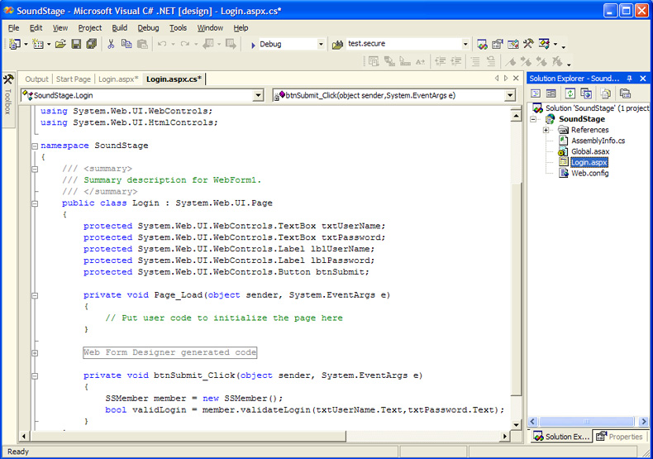
Design Classes
In OO programming every piece of code resides inside an object class
Notes:
Teaching Notes
If your students have programmed in .NET or in Java or in any other OO environment they should have noticed that the code they write always goes into a class. This connection can help students understand the next slide.

Slide 5
Types of Design Classes
Entity Class - contains business related information and implements analysis classes.
Interface Class - provides the means by which an actor interacts with the system.
A window, dialogue box, or screen.
For nonhuman actors, an application program interface (API).
Control Class - contains application logic.
Persistence Class - provides functionality to read and write to a database.
System Class - handles operating system-specific functionality.
Notes:
Teaching Notes
Why all these kinds of classes? Structuring the system this way makes the maintenance and enhancement of those classes simpler and easier.
Entity classes are what we worked with in Chapter 9 during object-oriented analysis.
The .NET code on the previous slide is an example of an interface class.
Control classes coordinate message among the other kinds of classes to implement a use case.
The code to handle database reading/writing could be built into the entity class. But having that functionality in a separate class keeps the entity class implementation-neutral, which makes it more reusable. We will talk more about the value of reusability later in the chapter.
System classes isolate the other options from the operating system to keep them implementation-neutral and more reusable.

Slide 6
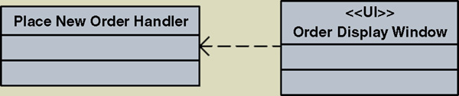
Design Relationships - Dependency
A dependency relationship is used to model the association between two classes:
To indicate that when a change occurs in one class, it may affect the other class.
To indicate the association between a persistent class and a transient class.
Interface classes typically are transient
Illustrated with a dashed arrow
Notes:
Teaching Notes
The Order Display Window is an interface class <<UI>>. It is dependent on the Order Processor class to respond to events initiated from the interface.

Slide 7
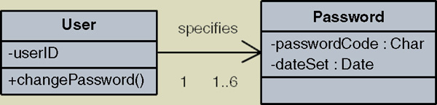
Design Relationships - Navigability
Classes with associations can navigate (send messages) to each other.
By default the associations are bidirectional.
Sometimes you want to limit the message sending to only one direction.
Illustrated with an arrow pointing in the direction a message can be sent.
Notes:
Teaching Notes
Given a User, you can find that user’s current password for authentication. But given a password, you cannot find the corresponding user.

Slide 8
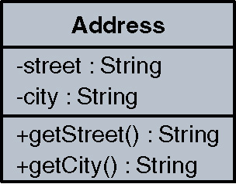
Attribute and Method Visibility
Visibility – the level of access an external object has to an attribute or method.
Public attributes/methods can be accessed/invoked by any other method in any other object or class. Denoted by the + symbol
Protected attributes/methods can be accessed/ invoked by any method in the same class or in subclasses of that class. Denoted by the # symbol
Private attributes/methods can be accessed/invoked by any method in the same class. Denoted by the – symbol
Method – the software logic that is executed in response to a message.
Notes:
No additional notes.

Slide 9
Object Responsibilities
Object responsibility – the obligation that an object has to provide a service when requested and thus collaborate with other objects to satisfy the request if required.
An object responsibility is implemented by the creation of methods that may have to collaborate with other objects and methods.
Notes:
Teaching Notes
Object responsibility is closely related to the concept of objects being able to send and/or respond to messages. For example, an ORDER object may have the responsibility to display a customer’s order, but it may need to collaborate with the CUSTOMER object to get the customer data, the PRODUCT object to get the product data, and the ORDER LINE object to get specific order data about each product being ordered. Thus, CUSTOMER, PRODUCT, and ORDER LINE have an obligation to provide the requested service (provide requested data) to the ORDER object.

Slide 10
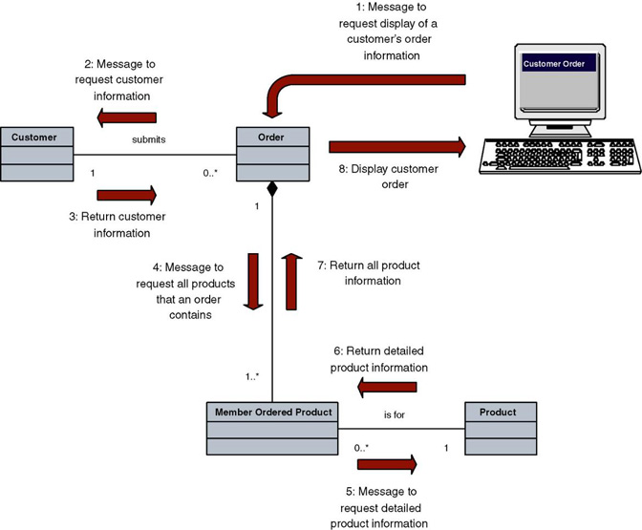
Object Responsibility
Notes:
No additional notes.

Slide 11
The Process of Object-Oriented Design
Refining the use case model to reflect the implementation environment.
Modeling class interactions, behaviors, and states that support the use case scenario.
Updating the class diagram to reflect the implementation environment.
Notes:
Teaching Notes
In performing object-oriented analysis (OOA) we identified objects and use cases based on ideal conditions and independent of any hardware or software solution. During object-oriented design (OOD) we want to refine those objects and use cases to reflect the actual environment of our proposed solution.

Slide 12
Refining The Use Case Model
Step 1: Transform the “Analysis” Use Cases to “Design” Use Cases
Implementation details
Controls
Window/web page names
Navigation instructions
Step 2: Update the Use Case Model Diagram and Other Documentation to Reflect any New Use Cases
Notes:
Teaching Notes
In this iteration of use case modeling, the use cases will be refined to include details of how the actor (or user) will actually interface with the system and how the system will respond to that stimulus to process the business event.
The manner in which the user accesses the system; via a menu, window, button, bar code reader, printer, etc. should be explicitly described in detail. The contents of windows, reports, and queries should also be specified within the use case. While refining use cases is often time consuming and tedious, it is essential that they are completed.

Slide 13
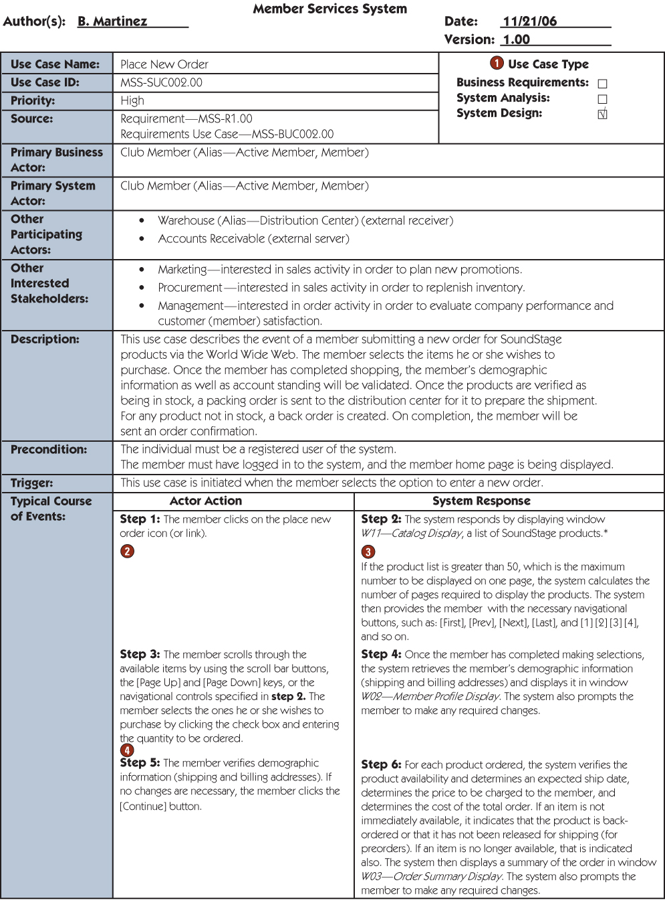
Design Use Case
Notes:
Teaching Notes
Notice that the course of events now describes the windows which will be displayed to the user, and the contents (i.e., field names) of the windows.
Descriptions of, error messages, special action buttons, possible cursor movements, and other window characteristics should be included in each design use case step.
The design use case step includes references to extension and abstract use cases. Recall that extension use cases extend the functionality of the original use case by extracting complex or hard to understand logic into its own use case. Abstract use cases are those that contain steps that are used by more than one design use case.

Slide 14
Modeling Class Interactions, Behaviors, and States
Step 1: Identify and Classify Use-Case Design Classes
Step 2: Identify Class Attributes
Step 3: Identify Class Behaviors and Responsibilities
Step 4: Model Object States
Step 5: Model Detailed Object Interactions
Notes:
Teaching Notes
In this activity we want to identify and categorize the design objects required by the functionality that was specified in each use case, and identify the object interactions, their responsibilities, and their behaviors.

Slide 15
Step 1: Identify and Classify Use-Case Design Classes
Interface, Control, and Entity Classes of Place New Order Use Case
Interface Classes | Controller Classes | Entity Classes
W00-Member Home Page W02-Member Profile Display W03-Display Order Summary W04-Display Order Confirmation W09-Member Account Status Display W11-Catalog Display W15-Product Detail Display | Place New Order Handler | Billing Address Shipping Address Email Address Active Member Member Order Member Ordered Product Product Title Audio Title Game Title Video Title Transaction
Notes:
Teaching Notes
The interface object column contains a list of objects mentioned in the use case that the users directly interface with, such as screens, windows, card readers, and printers. The only way an actor or user can interface with a system is via an interface object. Therefore, there should be at least one interface object per actor or user.
The controller object column contains a list of objects that encapsulate application logic or business rules. As a reminder, a use case should reveal one controller object per unique user or actor.
The entity object column contains a list of objects that correspond to the business domain objects whose attributes were referenced in the use case.

Slide 16
Step 2: Identify Class Attributes
Many attributes already identified during object-oriented analysis.
Revised use cases may mention additional attributes.
Must update class diagram to include new attributes.
Notes:
No additional notes.

Slide 17
Step 3: Identify Class Behaviors and Responsibilities
Analyze use cases to identify required system behaviors
Search for verb phrases
Some will reflect manual actions, others automated
Associate behaviors and responsibilities with classes
Model classes that have complex behavior
Examine class diagram for additional behaviors
Verify classifications
Notes:
No additional notes.

Slide 18
Condensed Behavior List
Condensed Behavior List for Place New Order Use Case
Behaviors | Class Type
Process new member order | Control
Retrieve product catalog information | Entity
Display W11-Catalog Display window | Interface
Retrieve member demographic information | Entity
Display W02-Member Profile Display window | Interface
Validate quantity amount | Entity
Verify the product availability | Entity
Determine an expected ship date | Entity
Determine cost of the total order | Entity
Display W03-Order Summary Display window | Interface
Prompt user | Interface
Check Status of member account | Entity
...
Notes:
Teaching Notes
Behaviors can be detected by identifying verbs in a use case narrative.
This is a partial list. See the text for the full list of behaviors
Some of the behaviors assigned to entity classes would eventually be implemented with persistence classes. However, the entity class would maintain the responsibility of calling the persistence class. Thus the entity class would retain the behavior.

Slide 19
Tools for Identifying Behaviors and Responsibilities
Class Responsibility Collaboration (CRC) Card - a card that lists all behaviors and responsibilities assigned to a class.
Often built interactively in a group setting that walks through a use case
Sequence diagram - a UML diagram that models the logic of a use case by depicting the interaction of messages between objects in time sequence.
Notes:
Teaching Notes
Different methodologies may emphasize one tool over the other or use other tools

Slide 20
CRC Card Listing Behaviors and Collaborators of a Class
Object Name: Member Order
Sub Object:
Super Object: Transaction
Behaviors and Responsibilities | Collaborators
Report order information Calculate subtotal cost Calculate total order cost Update order status Create Ordered Product Delete Ordered Product | Member Ordered Product
Notes:
Teaching Notes
CRC stands for Class Responsibility Collaboration.
The CRC card contains all use-case behaviors and responsibilities that have been associated with an object.
A CRC card for the object type MEMBER ORDER is depicted in the figure above. Notice that the CRC card contains all use case behaviors and responsibilities that have been associated with the object type MEMBER ORDER.
Also in the figure above, the MEMBER ORDER object needs collaboration from the MEMBER ORDERED PRODUCT object to retrieve information about each of the products being ordered. Remember if an object needs another object’s attribute to accomplish a behavior, the collaborating object needs to have a behavior or method to provide that attribute.

Slide 21
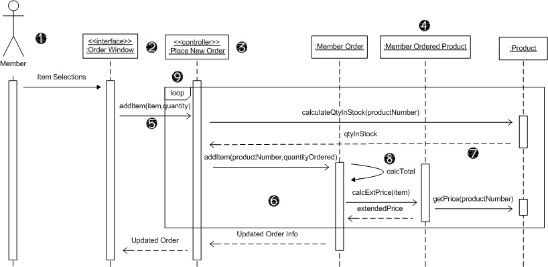
Sequence Diagram
Actor
Interface class
Controller class
Entity classes
Messages
Activation bars
Return messages
Self-call
Frame
Notes:
Teaching Notes
In class we often take a simple use case narrative, scan for verbs to identify behaviors, and interactively build a sequence diagram.

Slide 22
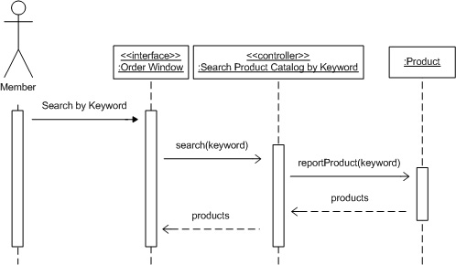
Another Sequence Diagram
Notes:
No additional notes.

Slide 23
Guidelines for Constructing Sequence Diagrams
Identify the scope of the sequence diagram, whether entire use-case scenario or one step.
Draw actor and interface class if scope includes that.
List use-case steps down the left-hand side.
Draw boxes for controller class and each entity class that must collaborate in the sequence (based on attributes or behaviors previously assigned).
Add persistence and system classes if scope includes that.
Draw messages and point each to class that will fulfill the responsibility.
Add activation bars to indicate object instance lifetimes.
Add return messages as needed for clarity.
Add frames for loops, optional steps, alternate steps, etc.
Notes:
No additional notes.

Slide 24
Step 4: Model Object States
Object state – a condition of the object at one point in its lifetime.
State transition event –occurrence that triggers a change in an object’s state through updating of one or more of its attribute values.
State machine diagram – a UML diagram that depicts:
the combination of states that an object can assume during its lifetime,
the events that trigger transitions between states,
the rules governing the objects in transition.
Notes:
Teaching Notes
The concept of state is depicted on the next slide.

Slide 25
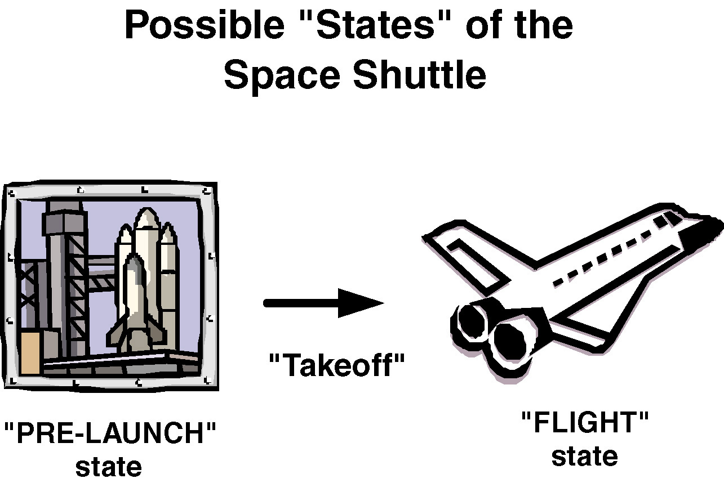
Object State Example
Notes:
No additional notes.

Slide 26
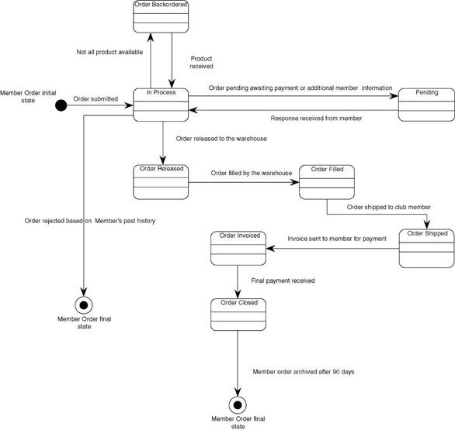
State Machine Diagram
Notes:
Teaching Notes
State machine diagrams are not required for all objects, just those that have clearly identifiable states and complex behavior.
The solid circle represents the object’s initial state.
The object transitions through a life cycle of different states represented by rounded-corner rectangles
Each arrow represents an event that triggers a change from one state to another
The solid circle inside the hollow circle represents the object’s final state.

Slide 27
Verifying Object Behavior and Collaboration
Role playing – the act of simulating object behavior and collaboration by acting out an object’s behaviors and responsibilities.
Participants may assume the role of an actor on an object type
Message sending is simulated by using an item such as a ball that is passed between the participants.
Useful for discovering missing objects and behaviors.
Notes:
No additional notes.

Slide 28
Updating Object Model to Reflect Implementation Environment
Design class diagram – a diagram that depicts classes that correspond to software components that are used to build the software application. Includes:
Classes
Associations and gen/spec and aggregation relationships
Attributes and attribute-type information
Methods with parameters
Navigability
Dependencies
Notes:
Teaching Notes
The Design class diagram is the design equivalent of the class diagram prepared in OOA (Chapter 9).

Slide 29
Transforming Analysis Class Diagram to Design Class Diagram
Add design objects to diagram
Add attributes and attribute-type information to design objects
Add attribute visibility
Add methods to design objects
Add method visibility
Add association navigability
Add dependency relationships
Notes:
No additional notes.

Slide 30
Four Implicit Object Behaviors
Create new instances
Update data or attributes
Delete instances
Display information
Notes:
Teaching Notes
When identifying behaviors, don’t forget these implied behaviors for every object.

Slide 31
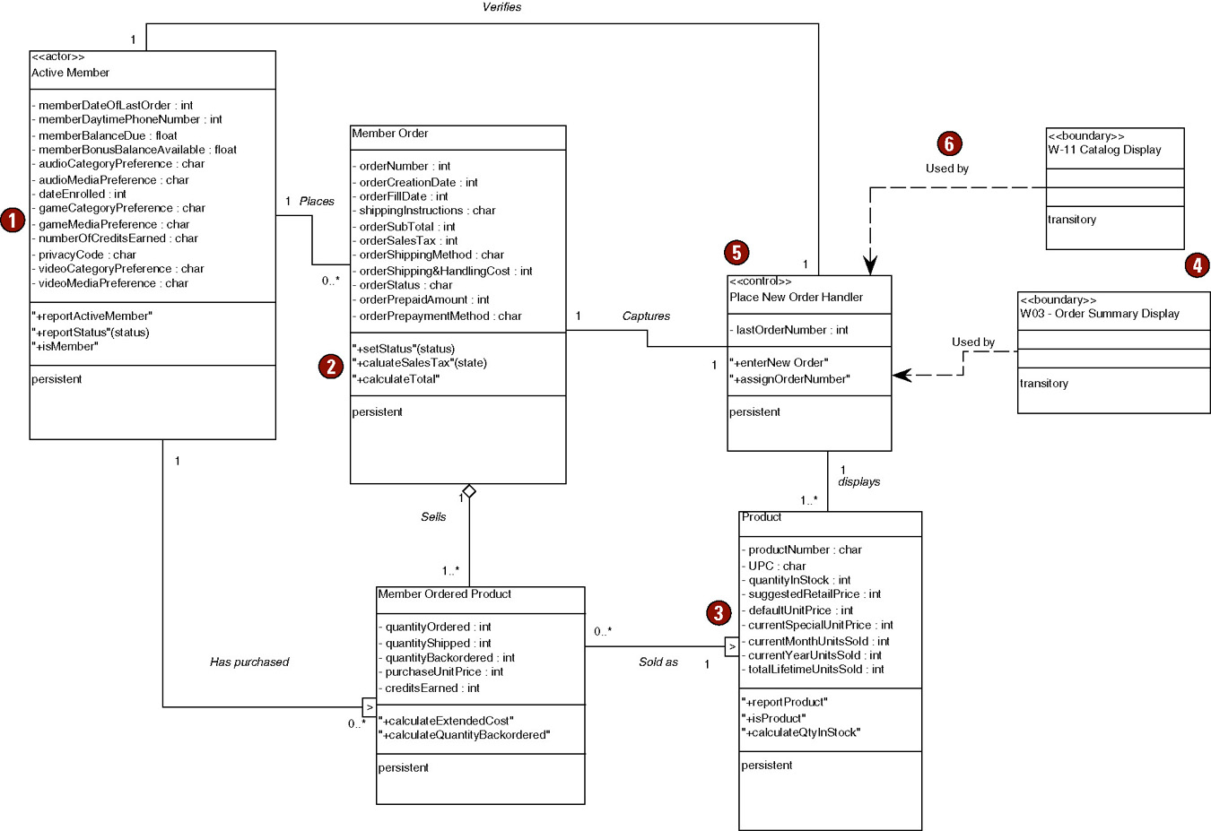
Partial Design Class Diagram
Notes:
Teaching Notes
The figure above is a partial view of our object class diagram which correlates to the objects used in the “Place New Member Order” use case. Notice we have given each behavior or method a name. Normally these names reflect the programming language used to develop the system.

